Slide 1
Stress and Frequency Analysis of Folded Spring- System in MEMS Gyroscope
Guided by: Dr. Howard Hu
Presented by: Andy Xiao, Vaibhav Wanere, Vicky Chen

Slide 2
Introduction
1. MEMS Gyroscope
2. Principle of Operation
3. Clamped Guided Folded Beam Structure

Slide 3
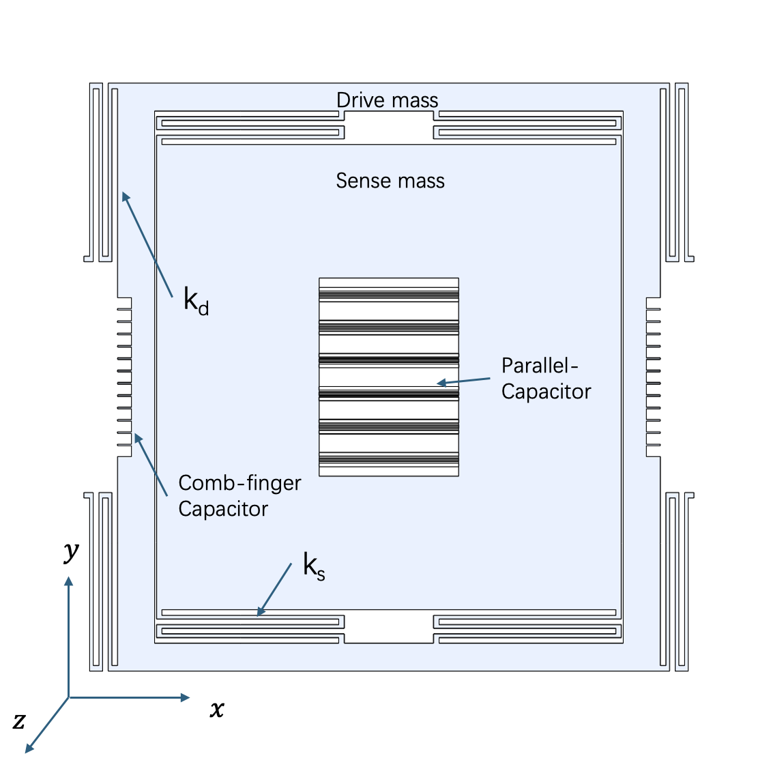
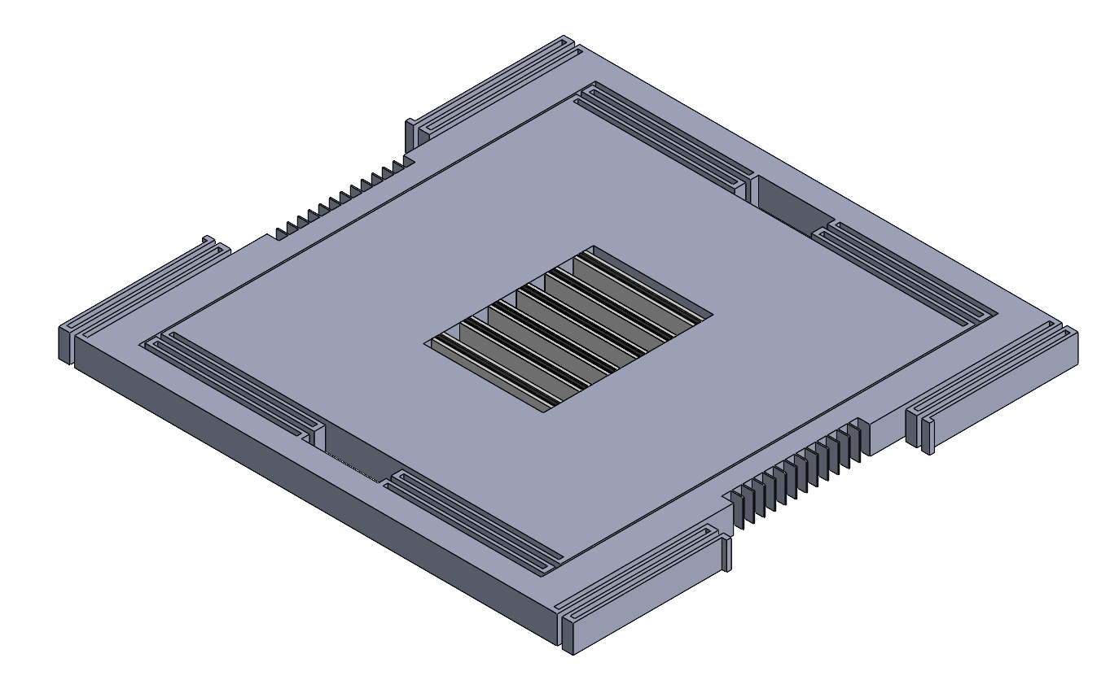
MEMS Gyroscope
MEMS Gyroscope Isometric View
MEMS Gyroscope Top View

Slide 4
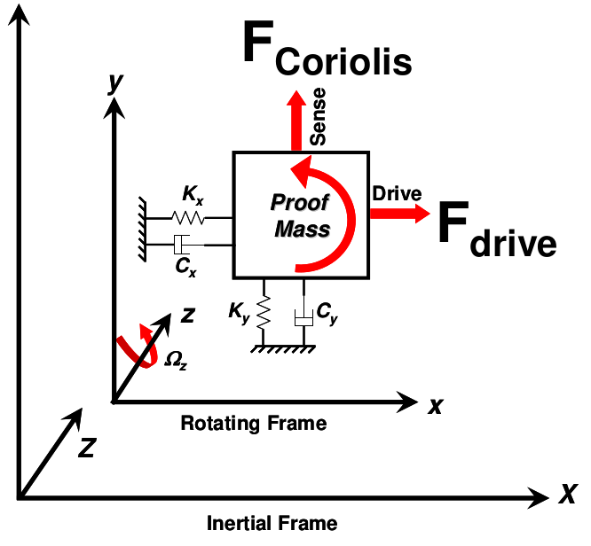
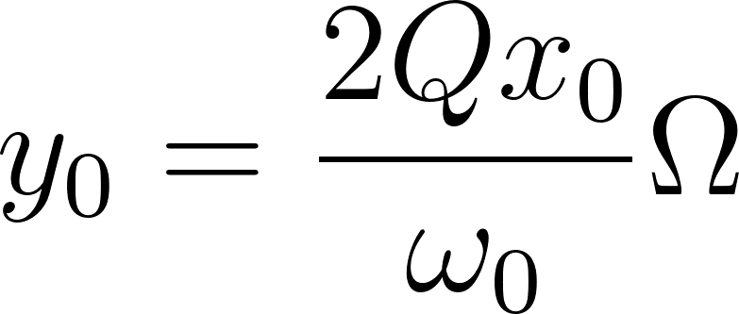
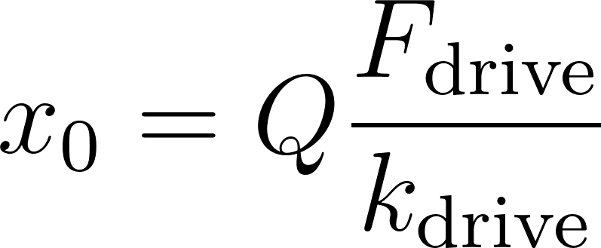
Principle of Operation

Slide 5
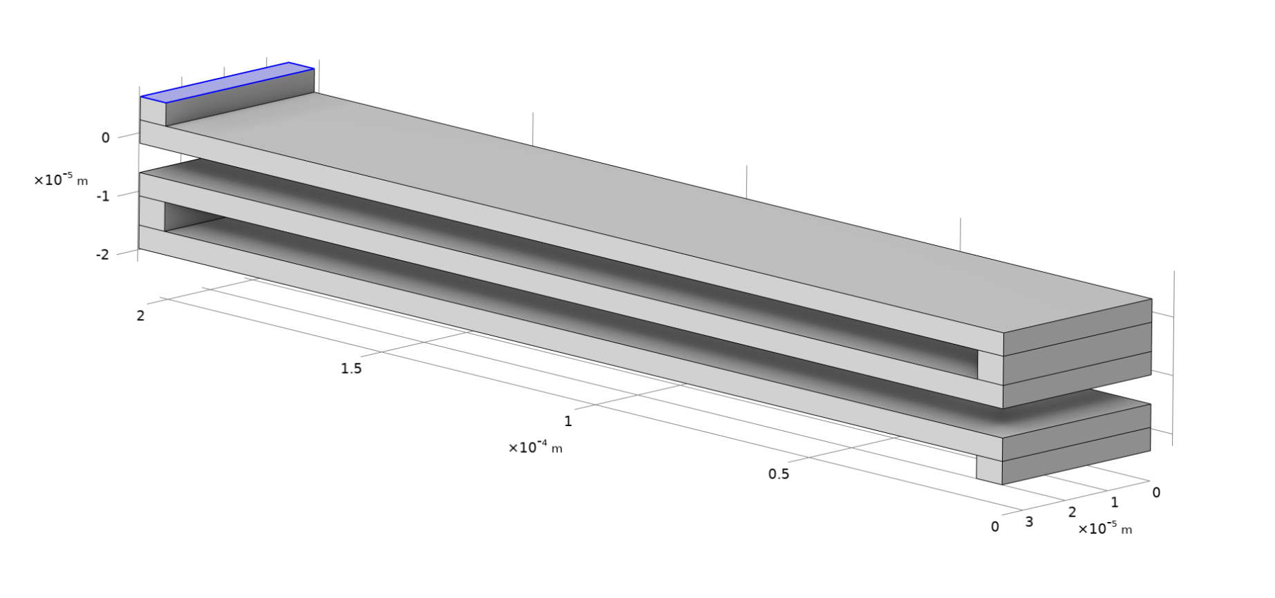
Clamped-Guided Folded Spring Structure
The drive mass and sense mass are connected to each other through a clamp guided spring structure as shown.

Slide 6
Finite Element Simulation
1. Boundary Conditions
2. Linear Elastic Solid Mechanics Model
3. Displacement of Beam
4. Eigenfrequency Analysis
5. Mesh Convergence

Slide 7
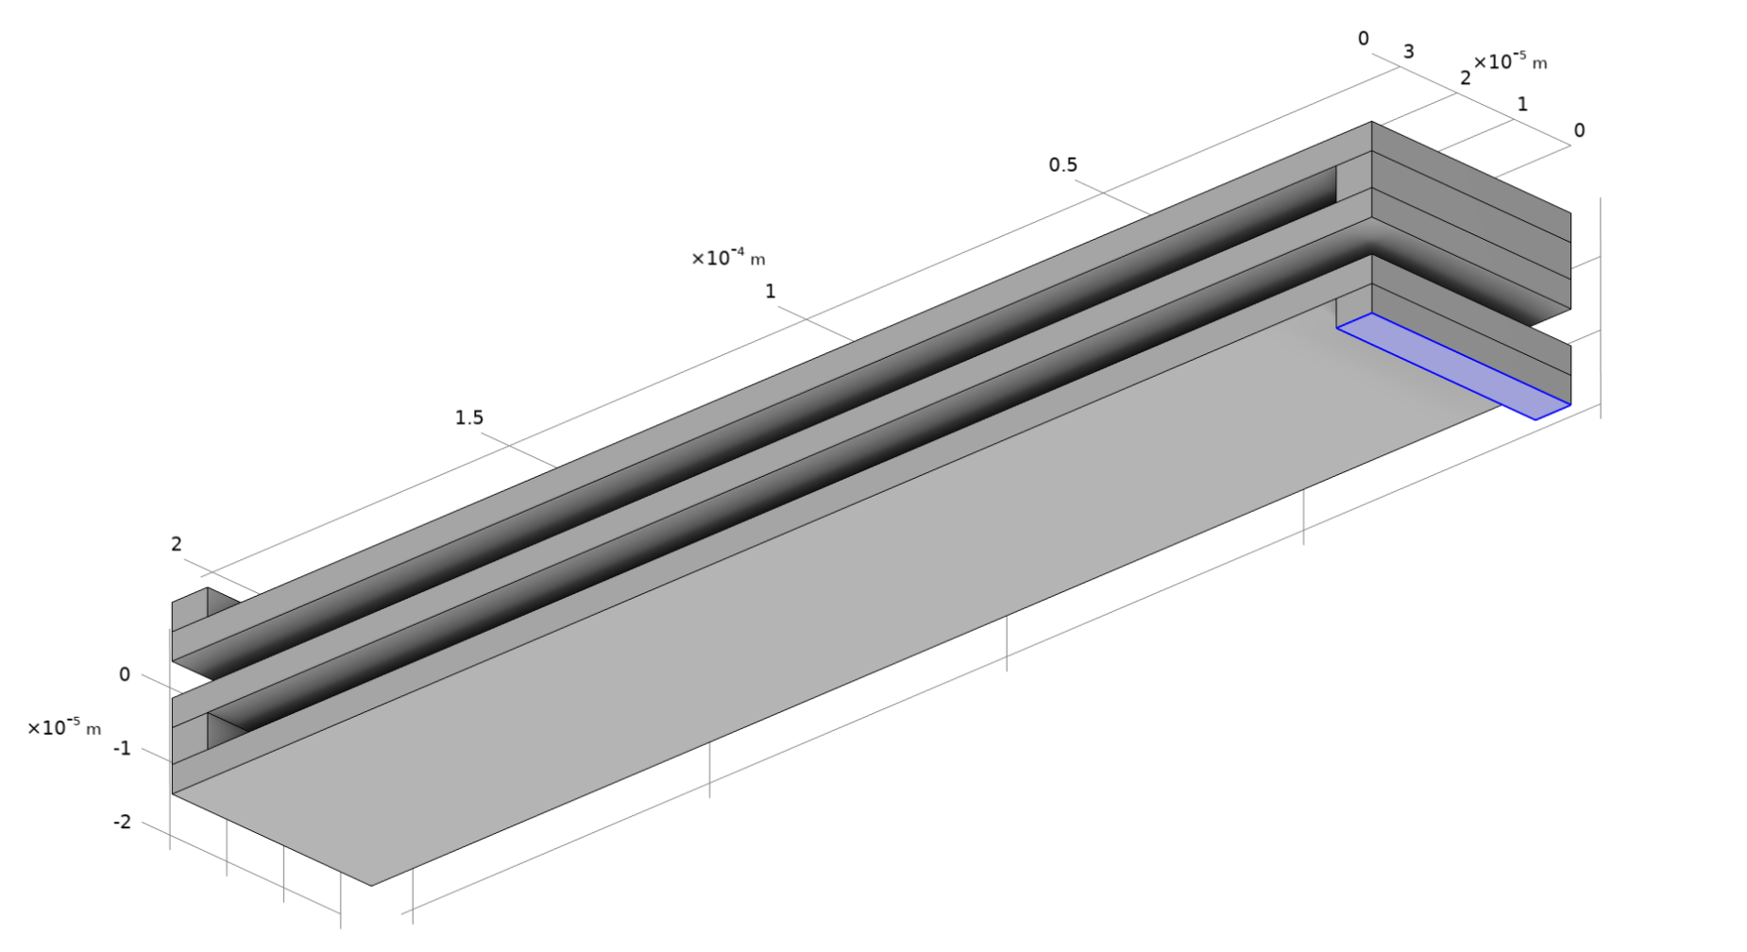

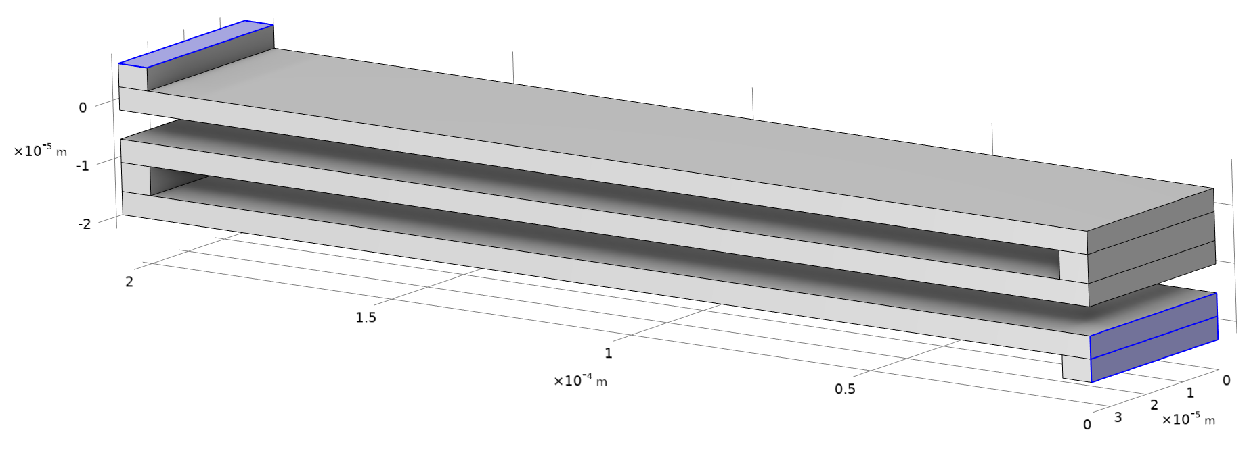

Boundary Conditions
Fixed Condition
Solid Mechanics-Total Force:
Roller Condition:
Eigenfrequency: Mass

Slide 8

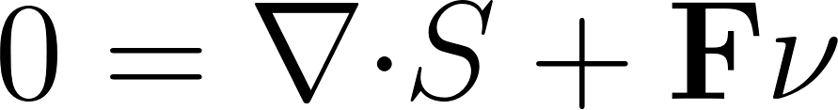

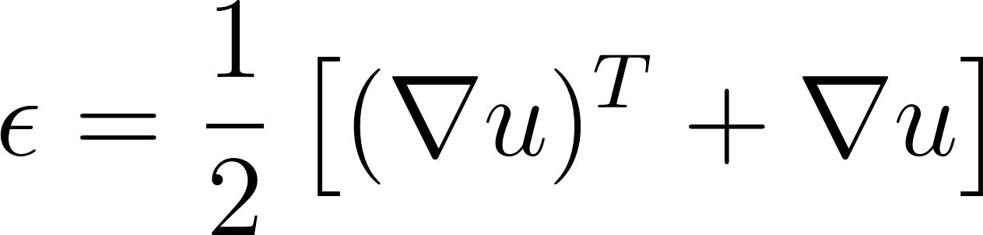

Linear Elastic Solid Mechanics Model
Gyroscope works in the linear elastic region of the stress-strain curve and well below the yield stress.
We can safely ignore the inelastic strains.
Stress Tensor
Force Equilibrium
Elastic Strain
Elastic Strain
Elastic Stress

Slide 9
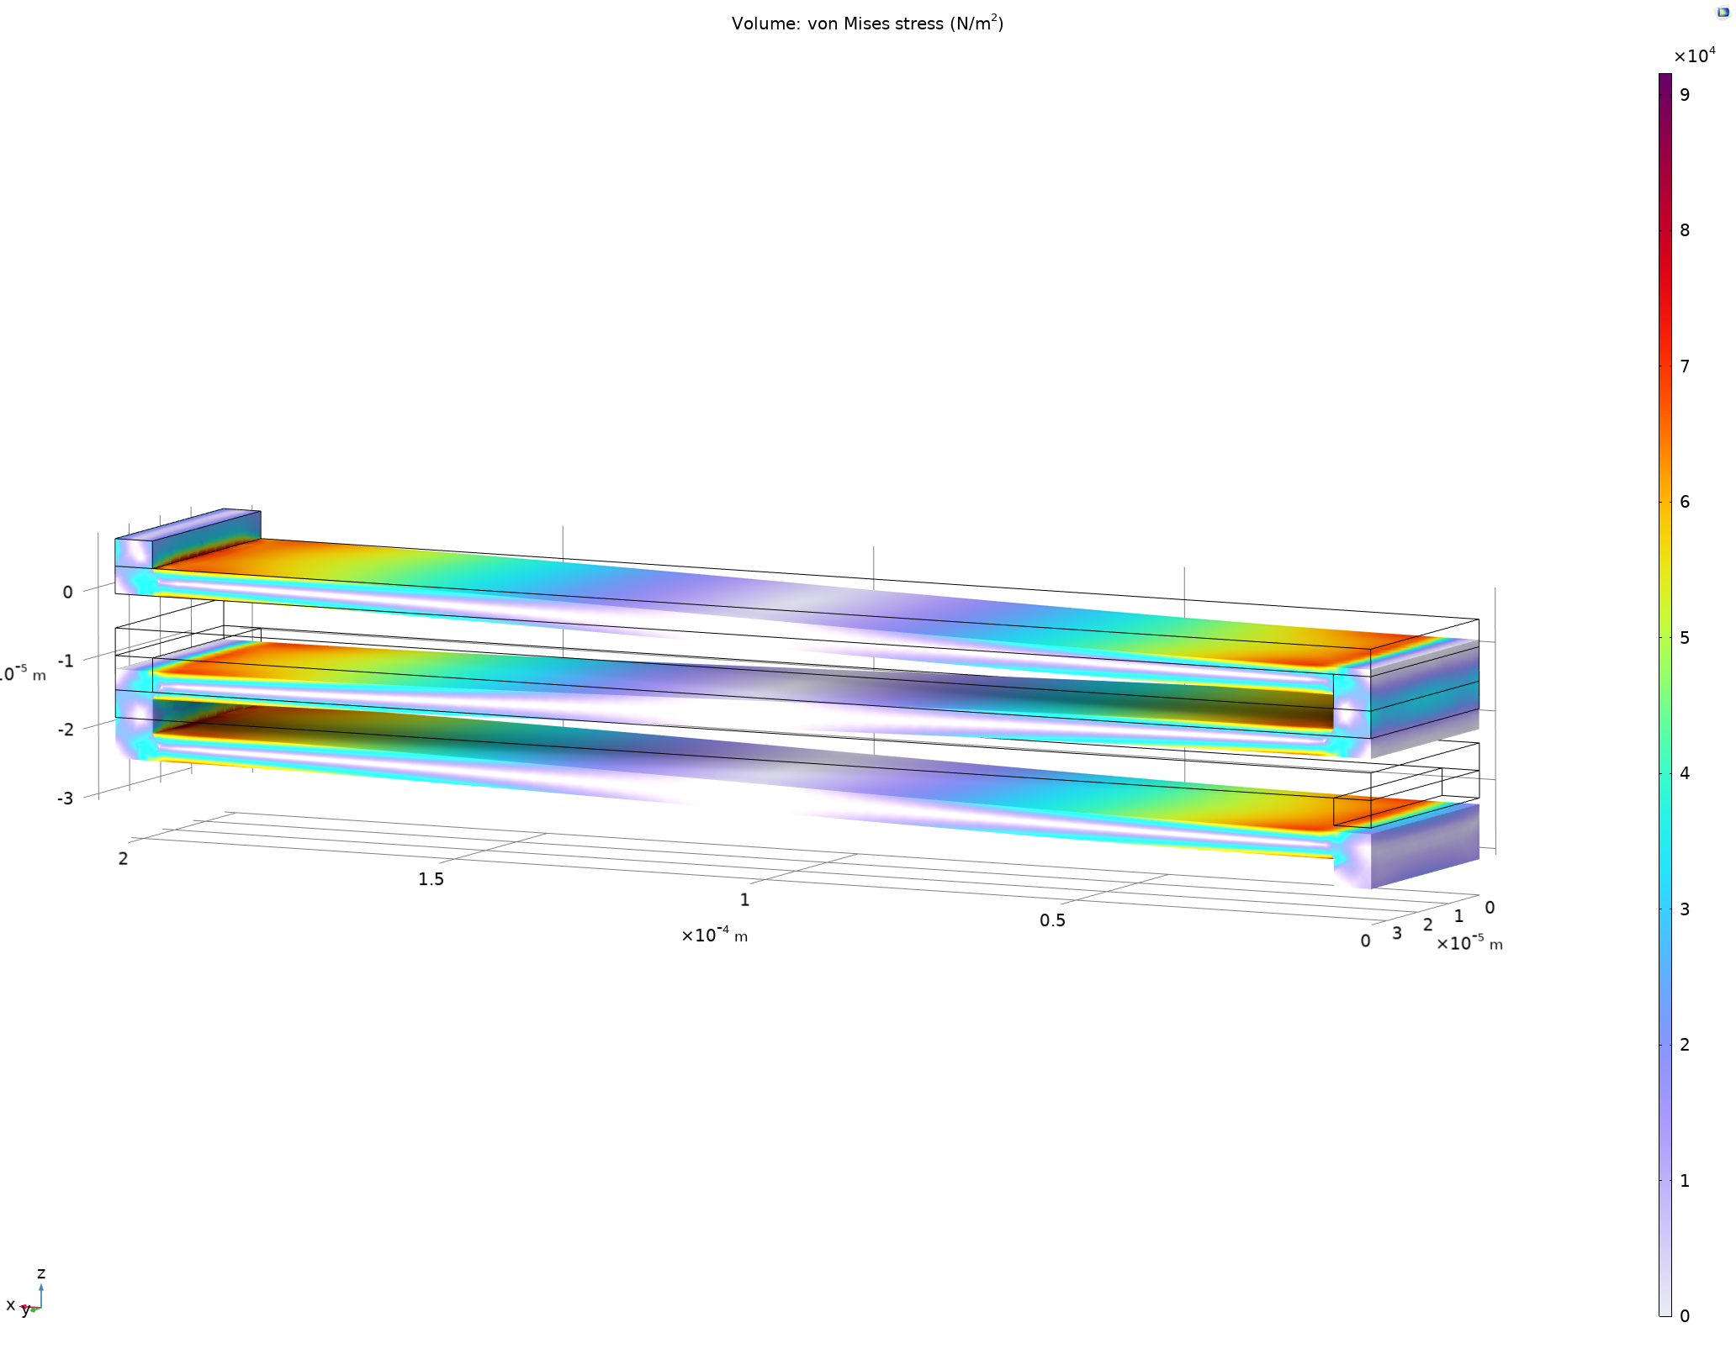
Linear Elastic Solid Mechanics Model
Von Mises Stress = 90000 Pa
Tensile Strength = 1.2 GPa
Material: Polysilicon

Slide 10
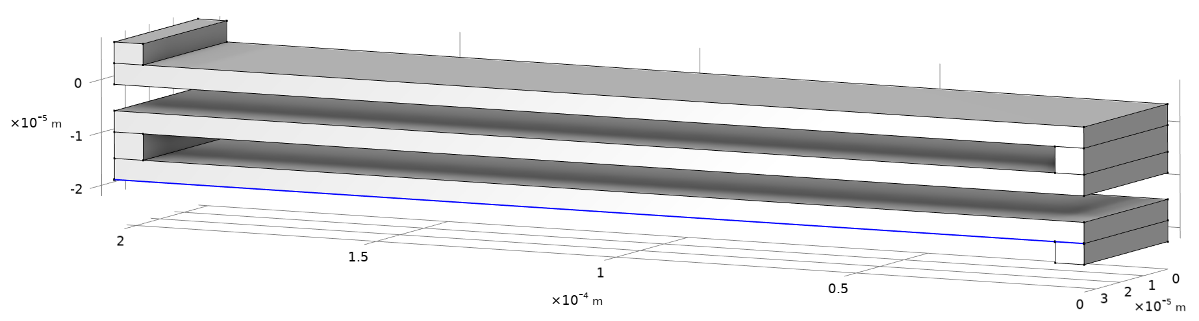
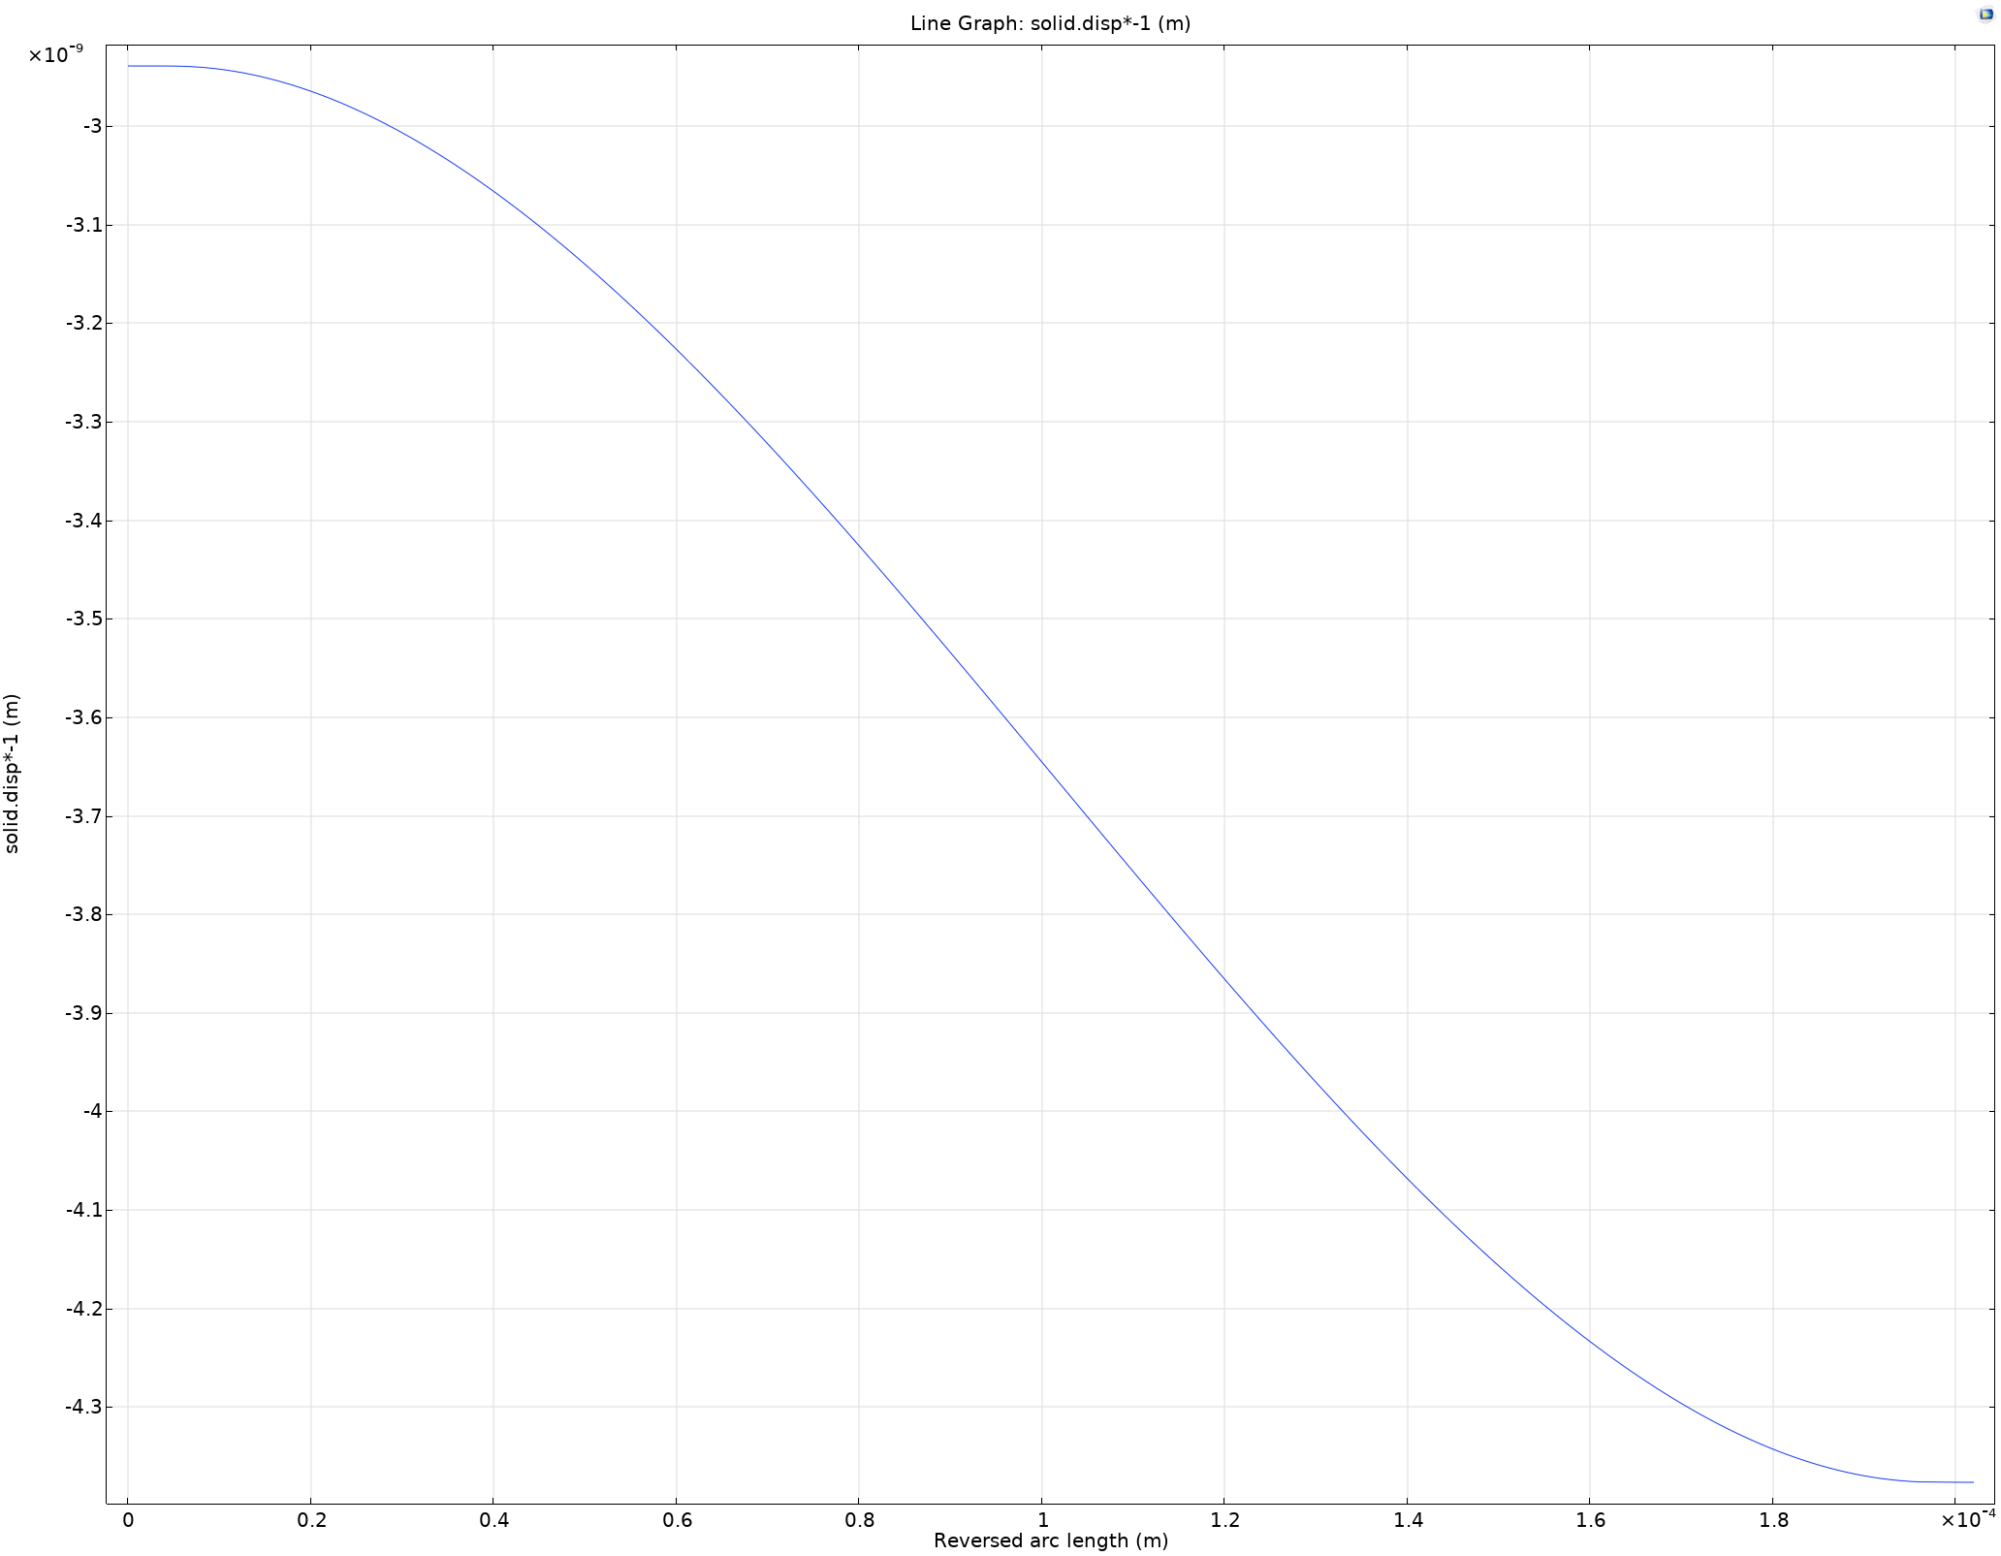
Displacement of Bottom Beam

Slide 11
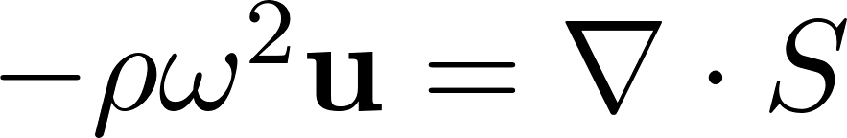

Eigenfrequency Analysis
The first eigenfrequency is the natural frequency f₀ of the folded spring structure.
For stress analysis, the eigenfrequency module uses the same equations as the ones in solid mechanics model (stress, strain, for equilibrium, and etc.).
The first equation states that the internal stresses within a vibrating body must balance the inertial forces generated by its oscillation.
The second equation relates the eigenvalue λ with the frequency of oscillation ω, where i is the imaginary number.

Slide 12
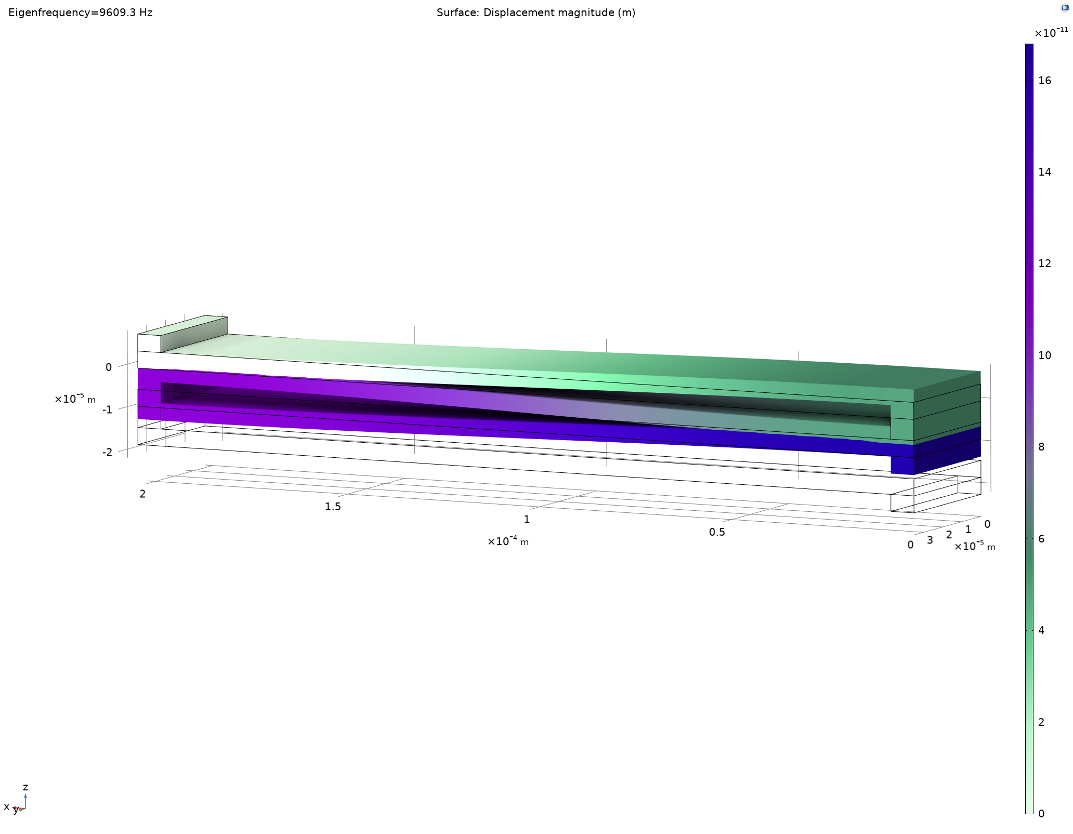
Eigenfrequency Analysis

Slide 13
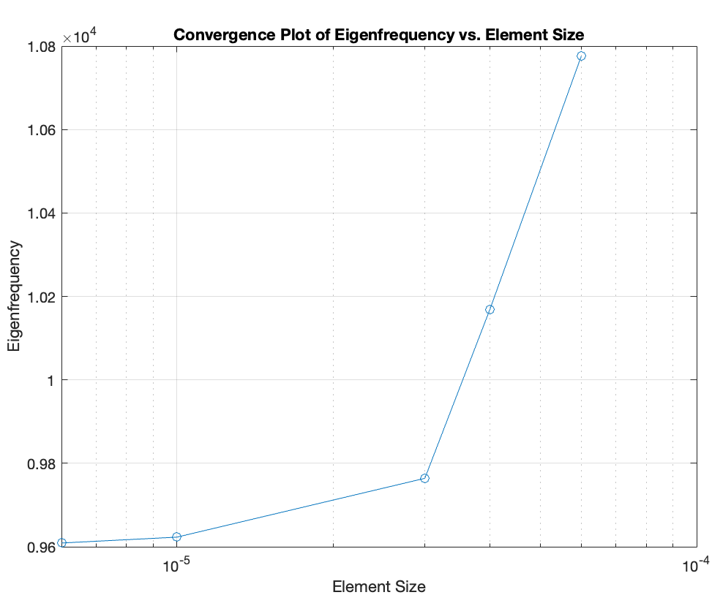
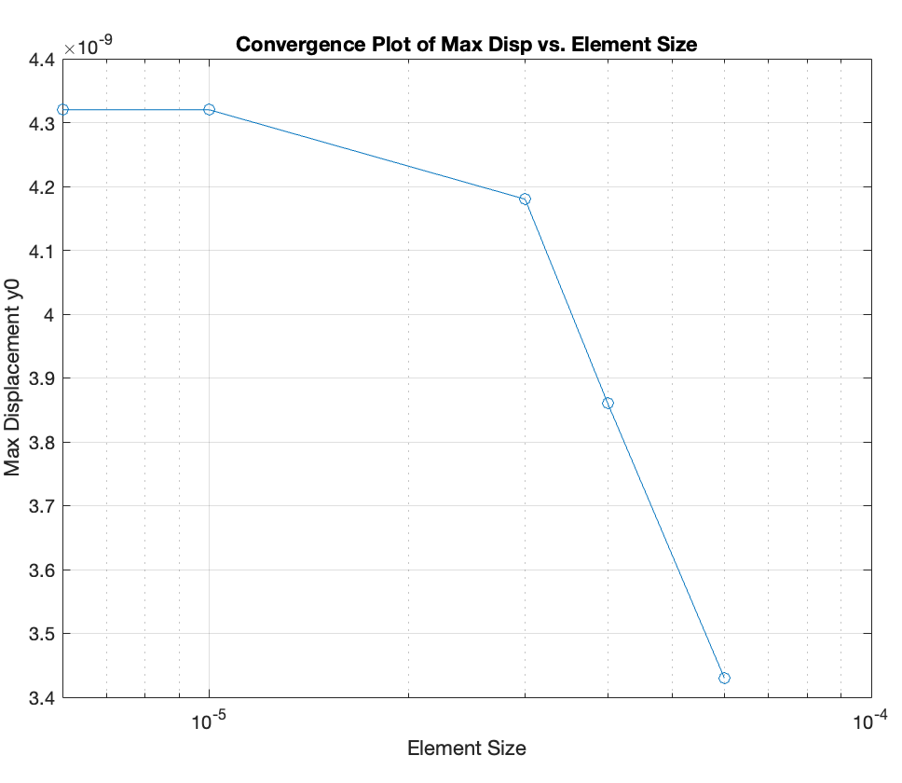
Mesh Convergence

Slide 14
Thank you!

